Slide 1
Password Strength Tester
- An OWASP-Based Cybersecurity Evaluation Tool -
Information Assurance and Security Project
BY : Rania Mestiri (Acct/IT)

Slide 2
ROADMAP
PROBLEM INTRODUCTION
PROJECT OBJECTIVES
PASSWORD ATTACKS
SECURITY PARAMETERS
EXISTING SOLUTIONS
SYSTEM OVERVIEW
SYSTEM ARCHITECTURE
DEVELOPMENT PHASE

Slide 3
PROBLEM INTRODUCTION
In today’s digital world, passwords are the cornerstone of digital security, they are the first line of defense against unauthorized access.
However, weak or easy-to-guess credentials continue to be one of the leading causes of security breaches.
Many users prioritize convenience over complexity, which makes them vulnerable to attacks such as brute force, dictionary, credential stuffing, or social engineering.

Slide 4
PROJECT OBJEcTIVES
This Password Strength Tester aims to :
evaluates how secure a password is based on key parameters : length, complexity, entropy, use of numeric and special characters, and the avoidance of personal or publicly known information.
encourages the use of passphrases which are both user-friendly and highly resistant to attacks.
provides immediate feedback indicating whether it is a weak, moderate, or strong password, highlighting specific weaknesses and suggesting improvements.

Slide 5
PASSWORD
ATTACKS
Brute Force Attacks : Trial & Error
Attackers check every possible character combination until the key is found.
Example: The Math of Guessing
4-Digit PIN: 10,000 combinations. -> Cracked in seconds.
12-Char (Complex): extremely large. -> Requires a year or more to crack.
Dictionary Attacks : Predictable Wordlists
Attackers use a list of common words or leaked passwords to guess the right one.
Example: Pattern Permutations
password → P@ssw0rd!
admin → @dm1n_2024
=> Reduces guessing time from years to minutes.
5

Slide 6
PASSWORD
ATTACKS (cont.)
Credential Stuffing : The Breach Domino Effect
Attackers reuse passwords stolen from data breaches on other websites.
Example: Cross-Platform Takeover
A leaked password from one site gives access to multiple other accounts.
Social Engineering : The Human Element
Attackers manipulate users into giving up their credentials or take guesses based on personal information.
Example: Intelligence Gathering
Finds your dog's name "Rex" → Rex_2015
Phishing: A fake "Password Expired" email redirects you to a malicious site.
6

Slide 7
SECURITY PARAMETERS
OWASP Evaluation CriteriA
Password Strength : The most important key requirements are
Minimum length (8–12 characters)
Uppercase and lowercase letters
At least one number
At least one special character
Avoid common passwords
Avoid using username in the password
Password Entropy : Measures the unpredictability of a password, directly indicating its resistance to attacks.
The more random a password is, the higher entropy is.
Longer combinations are harder to guess.
« MySecurepassW@987 » compared to « name123 ».

Slide 8
EXISTING SOLUTIONS OVERVIEW
TOOL | CORE FUNCTION | ADVANTAGE | LIMITATION
Zxcvbn (Dropbox) | Pattern analysis | Accurate & widely used | Requires large dictionary dataset
Kaspersky Password Checker | Known breach check | Known leak detection | Requires internet connection
Bitwarden Password Tool | Entropy evaluation | Password generation | Limited advanced pattern analysis

Slide 9
SYSTEM OVERVIEW
The Password Strength Tester :
Accepts username and password input from user
Analyzes the password entered
Checks it against a set of predefined security rules
Evaluates the security level
Calculates a strength score
Provides feedback : weak, medium, or strong password.
Sends tips to create a safer password.
The goal -> help users understand the quality of their passwords and encourage stronger password creation.

Slide 10
SYSTEM ARCHITECTURE COMPONENTS
1/ USER INTERFACE
Accepts input
Displays results and feedback
2/ INPUT VALIDATION MODULE
Checks empty fields & input format
3/ PASSWORD ANALYSIS MODULE
Checks password against security rules
4/ STRENGTH EVALUATION MODULE
Calculates the strength score
5/ FEEDBACK GENERATOR
Sends suggestions & improvements to UI

Slide 11
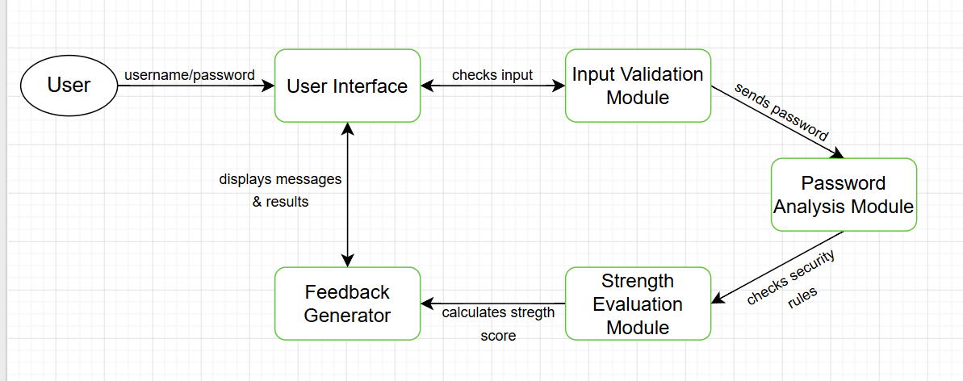
ARCHITECTURE
DIAGRAM
DATA
EXCHANGED
User → UI | Username / Password
UI → Validation | Input data
Validation → Analysis | Password
Analysis → Evaluation | Security rules results
Evaluation → Feedback | Strength score
Feedback → UI | Result / suggestions

Slide 12
DEVELOPMENT PHASE
Requirement Analysis : Defining project objectives, concepts, and the security requirements.
System Design : Setting the main components of the system architecture and the data flow.
Implementation : Developing the web-based application.
Testing : Verifying password evaluation logic and accuracy.
Deployment and Documentation : Uploading project files and documents on GitHub.

Slide 13
Application Demo
http://127.0.0.1:5500/index.html

Slide 14
- THANK YOU -

